Slide 1
Prompting Techniques,Dspy and HuggingFace Pipelines

Slide 2
The LLM temperature setting
Temperature controls randomness in sampling:
At temperature = 0, the model is deterministic → same reasoning path every time → same answer.
At temperature > 0 (e.g., 0.7–1.0), the model explores different reasoning paths → diverse answers.
Example: Question: “What is 23 × 47?”
With temperature = 0:
Model always produces the same reasoning steps → same answer.
With temperature = 0.8:
Path A: “23 × 47 = 20 × 47 + 3 × 47 = 940 + 141 = 1081.”
Path B: “Break into 23 × 50 − 23 × 3 = 1150 − 69 = 1081.”
Path C: “Use long multiplication: 23 × 47 = 1081.”
Final step: Majority vote → 1081 (correct).

Slide 3
Zero Shot Prompting
Zero-shot prompting means that the prompt used to interact with the model won't contain examples or demonstrations. The zero-shot prompt directly instructs the model to perform a task without any additional examples to steer it.

Slide 4
Few Shot Prompting
We provide demonstrations in the prompt to steer the model to better performance. The demonstrations serve as conditioning for subsequent examples where we would like the model to generate a response.
Prompt:
This is awesome! // Negative
This is bad! // Positive
Wow that movie was rad! // Positive
What a horrible show! //
Output : Negative
Prompt:
Evaluate if these numbers can reach 24
(Sure/likely/impossible)
10 14 : 10+14=24 , Sure
6 4 : 6x4 =24 , Sure
24 1 : 24x1=24 , Sure
25,2 : 25-2=23 ,25x2=50, impossible
12 2
Output :
12 2

Slide 5
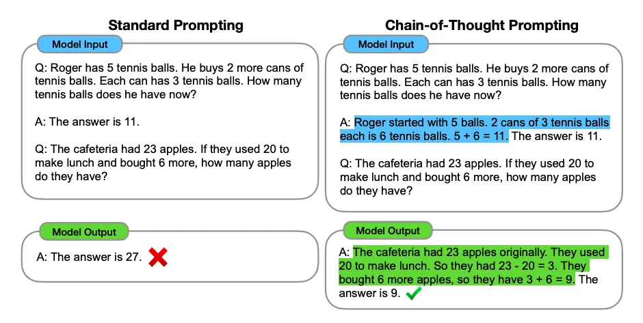
Chain of Thought Prompting
Mirror human problem solving methods of decomposing problems into smaller problems.
Enables complex reasoning capabilities through intermediate reasoning steps. You can combine it with few-shot prompting to get better results on more complex tasks that require reasoning before responding.

Slide 6
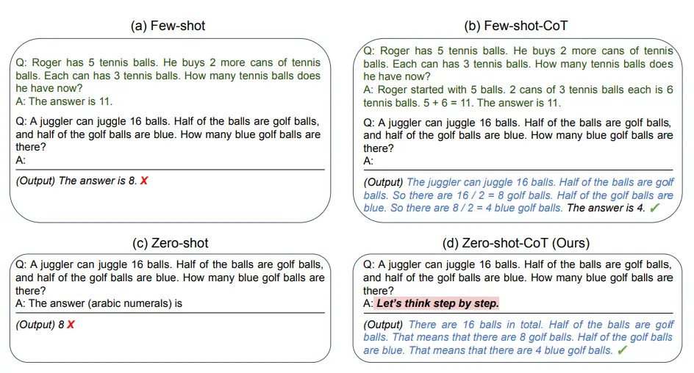
Chain of Thought Prompting

Slide 7
React Prompting
LLMs are used to generate both reasoning traces and task-specific actions in an interleaved manner.
Generating reasoning traces allow the model to induce, track, and update action plans, and even handle exceptions. The action step allows to interface with and gather information from external sources such as knowledge bases or environments.
The ReAct framework can allow LLMs to interact with external tools to retrieve additional information that leads to more reliable and factual responses.

Slide 8
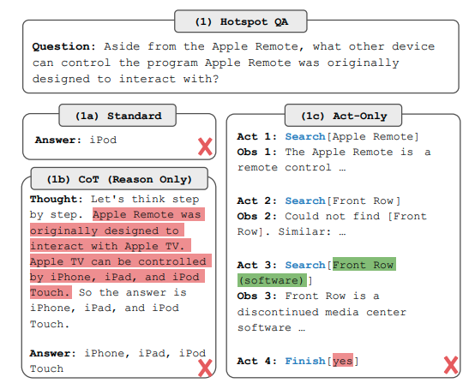
Comparison of prompting methods: CoT,Act only, Standard

Slide 9
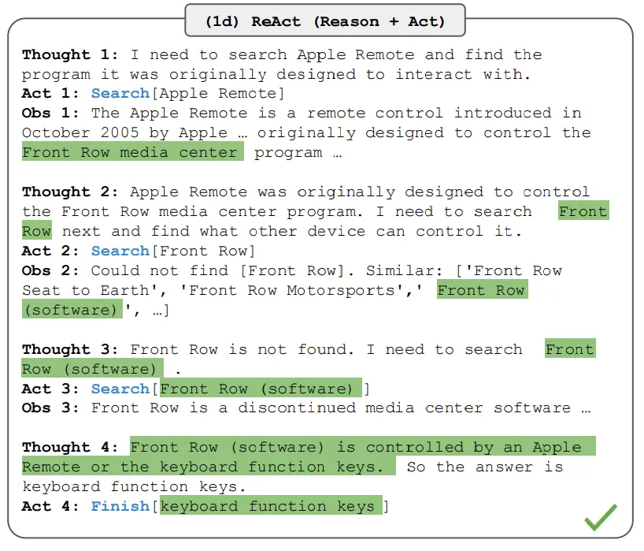
Comparison of prompting methods : React

Slide 10
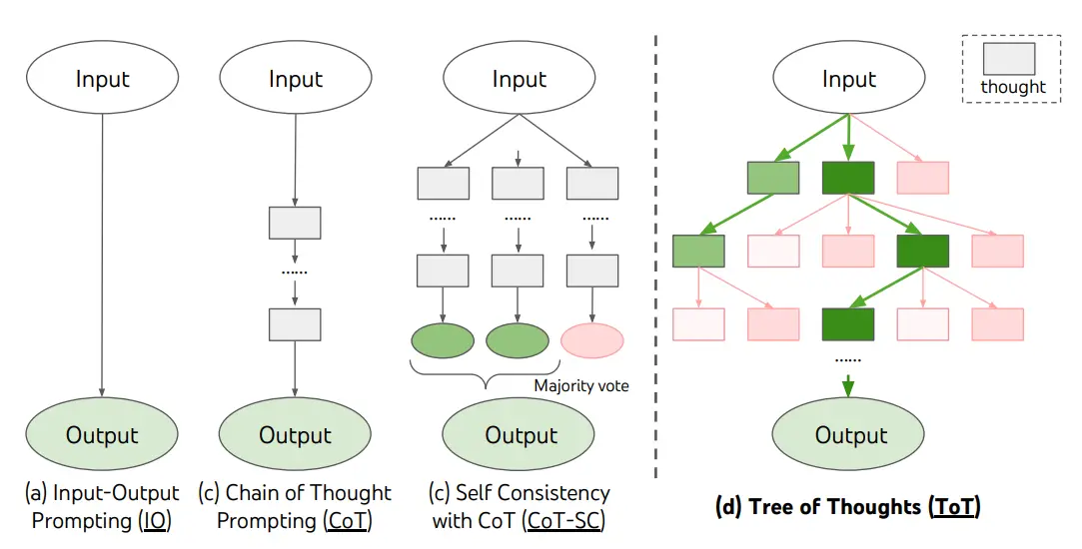
Tree of Thought (Princeton/Deepmind)
Notes:
Dont generate a solution, generate thoughts to proceed towards a solution

Slide 11
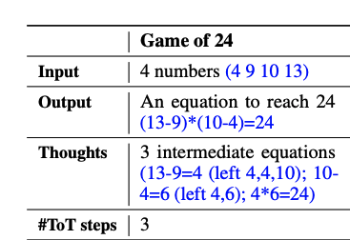
Sample Tree of Thought task: The game of 24
For example, given input “4 9 10 13”, a solution output could be “(10 - 4) * (13 - 9) = 24”
Decompose the thoughts into 3 steps, each involving an intermediate equation on 2 remaining numbers. At each step, the best b=5 candidates are kept.

Slide 12
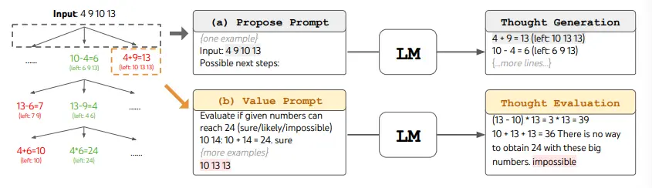
Tree of Thought
To perform BFS in ToT for the Game of 24 task, the LM is prompted to evaluate each thought candidate as "sure/maybe/impossible" with regard to reaching 24. As stated by the authors, "the aim is to promote correct partial solutions that can be verdicted within few lookahead trials, and eliminate impossible partial solutions based on "too big/small" commonsense, and keep the rest "maybe"". Values are sampled 3 times for each thought.

Slide 13
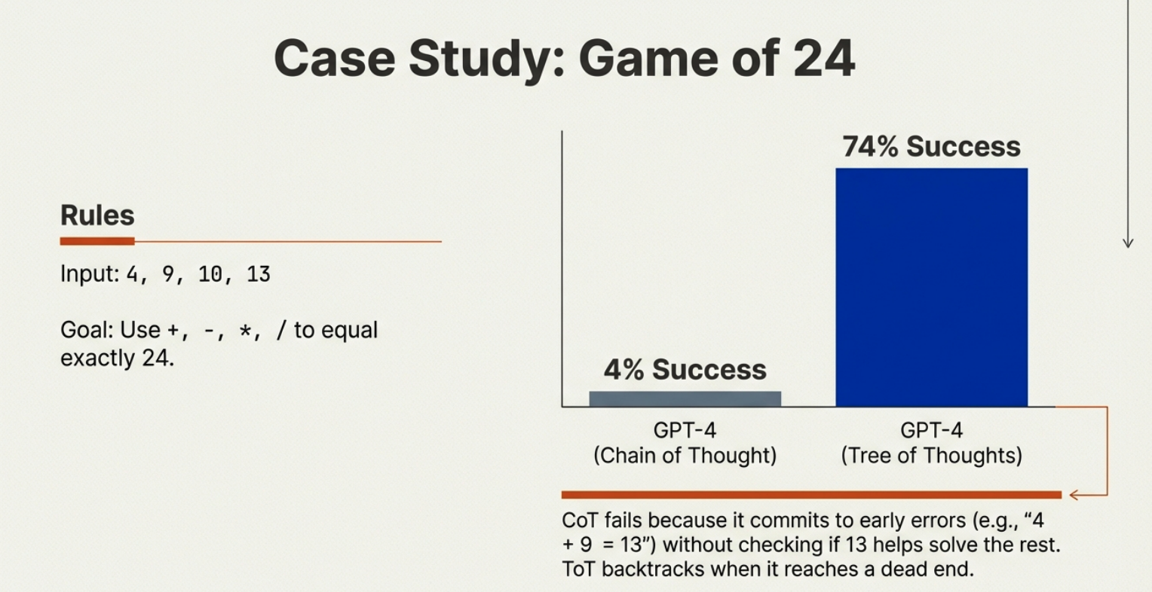
Tree of Thought

Slide 14
Enforcing validation on Responses with Pydantic
Schema enforcement: You define exactly what fields you expect (score, reasoning), their types, and constraints.
Validation: If the LLM produces malformed or incomplete output, Pydantic raises an error instead of silently passing bad data.
Parsing: Converts raw text into Python objects automatically, so you can work with structured data instead of strings.
Documentation: Field descriptions double as guidance for the LLM, nudging it to produce the right format.
Reproducibility: Ensures outputs are consistent across runs,

Slide 15
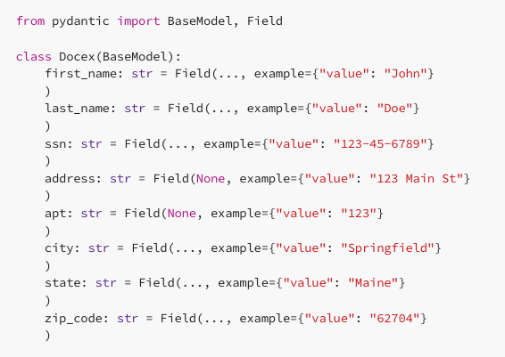
Pydantic example: Extract Name,SSN, and Address

Slide 16
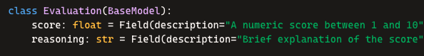
Pydantic example: structured scoring
Ensure the LLM produces valid API calls with method, endpoint, and parameters.
LLM output:
json
{"score": 7.5, "reasoning": "The move creates a multiple of the target"}
Pydantic validates:
score is a float between 1 and 10.
reasoning is a string.
If valid → you get a clean Evaluation object in Python.

Slide 17
DSPy (Stanford paper)

Slide 18
Dspy: Compiling Declarative LLM calls
Signatures
Define WHAT
The contract between inputs and outputs.
Example:
Input:English doc Output: Translation
Modules
Define HOW: Encapsulate reusable logic to structure your program
Optimizers
Auto optimizes prompts by running them against the set of sample data
Metrics
Define what to optimize against
Notes:
Signatures replace prompts

Slide 19
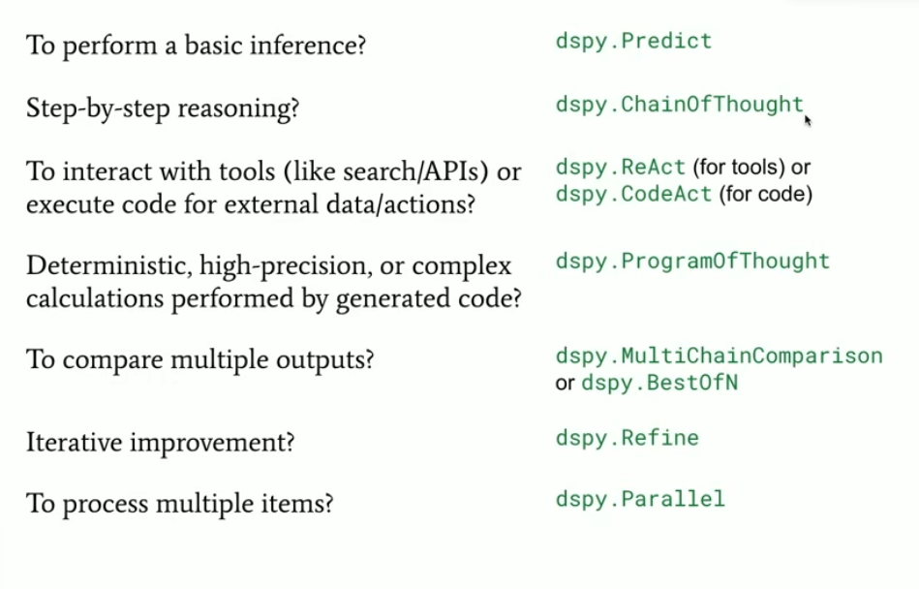
Modules
Intent | Use

Slide 20
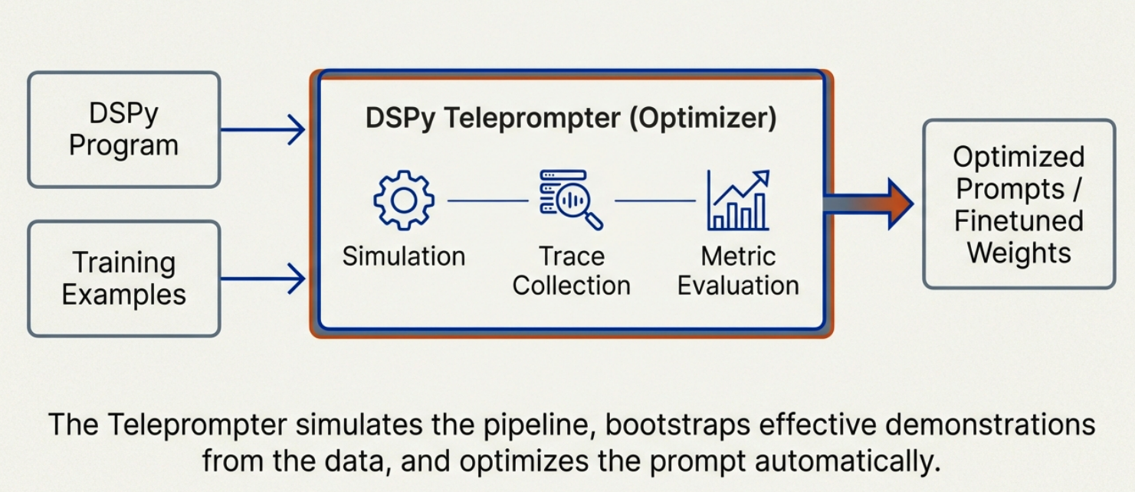
The Optimizer

Slide 21
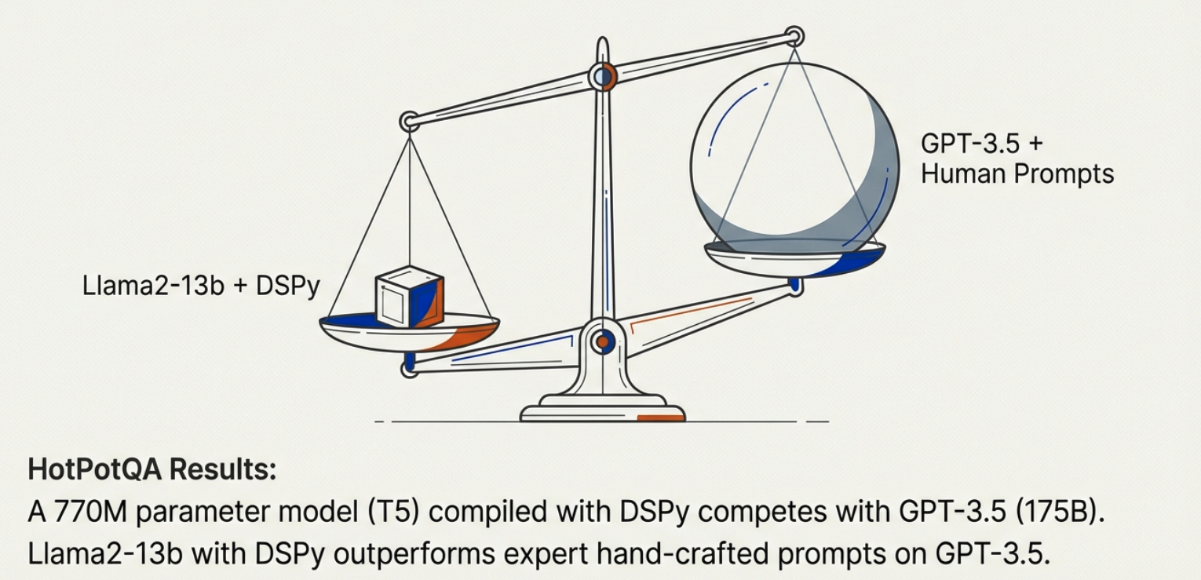
DSPy can enable small models to outperform

Slide 22
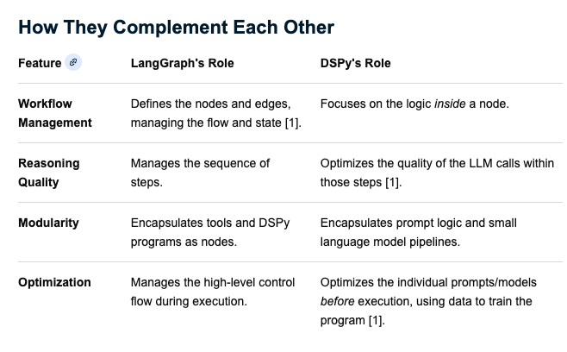
DSPy or Langraph:How do I choose ?

Slide 23
Using Dspy and Langgraph Together
You can use DSPy modules inside LangGraph nodes:
Define a DSPy program (e.g., a multi‑hop question reasoning optimizer).
Wrap that program as a callable function.
Place it in a LangGraph node, so the graph orchestrates when and how DSPy runs.
Other nodes can handle retrieval, tool calls, or post‑processing.
This way:
LangGraph manages the workflow orchestration.
DSPy ensures each reasoning step is optimized and reliable.

Slide 24
HuggingFace Pipelines API

Slide 25
What is HuggingFace
A leading platform for machine learning and natural language processing (NLP).
Hosts thousands of pre‑trained models (LLMs, vision, audio, etc.).
Provides tools like Transformers library, Datasets, and Spaces for deploying ML apps.
Community‑driven: researchers, developers, and companies share models openly.

Slide 26

Getting Started
Go to huggingface.co.
Click Sign Up (top right).
Enter your email, username, and password.
Verify your email address.
Log in to access your profile and models.

Slide 27
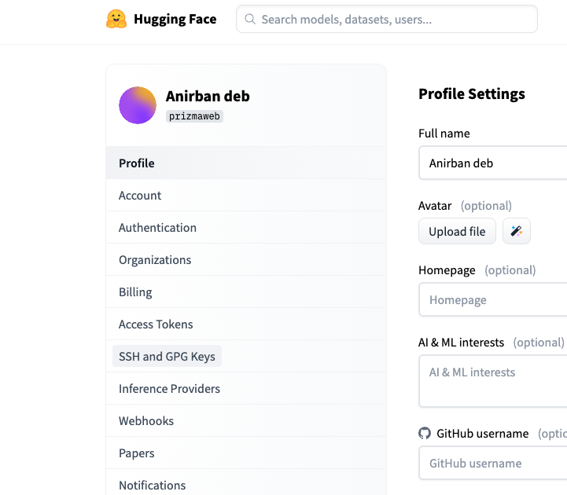
Generate an access token
While logged in, click your profile picture → Settings.
Navigate to Access Tokens.
Click New Token.
Choose the name (HF_TOKEN).
Select write for token type
Copy the generated token — keep it private!

Slide 28
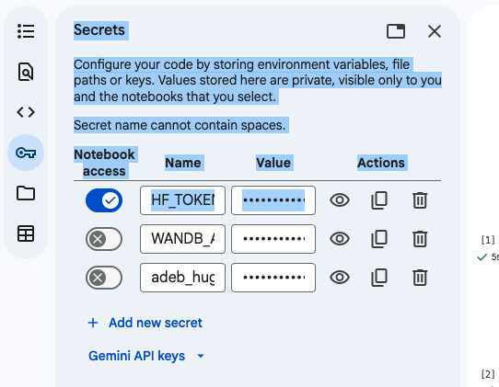
Add the token in your Google Colab notebooks

Slide 29
LLM Hello World Program
from transformers import AutoTokenizer, AutoModelForCausalLM
# Load tokenizer and model automatically
tokenizer = AutoTokenizer.from_pretrained("gpt2")
model = AutoModelForCausalLM.from_pretrained("gpt2")
# Encode and generate
inputs = tokenizer("Hello world, How are you", return_tensors="pt")
outputs = model.generate(**inputs, max_length=30)
print(tokenizer.decode(outputs[0]))

Slide 30
Pipelines
High‑level API in Hugging Face’s transformers library.
Simplifies using pre‑trained models for common tasks.
The pipeline() abstraction handles tokenization, model inference, and decoding automatically.
Consistency: Same interface across tasks (text, vision, audio).
Flexibility: Swap models easily by changing the model name.
A pipeline consists of:
One or more components for pre-processing model inputs, such as a tokenizer, image_processor, feature_extractor, or processor.
A model that generates predictions from the inputs.
Optional post-processing steps to refine the model’s output, which can also be handled by processors.

Slide 31
Task Specific Pipelines
Dedicated classes for specific tasks (e.g., TextClassificationPipeline, QuestionAnsweringPipeline).
Provide fine‑grained control and customization beyond the general pipeline().
Useful when you need to tweak preprocessing, postprocessing, or integrate into larger systems.

Slide 32
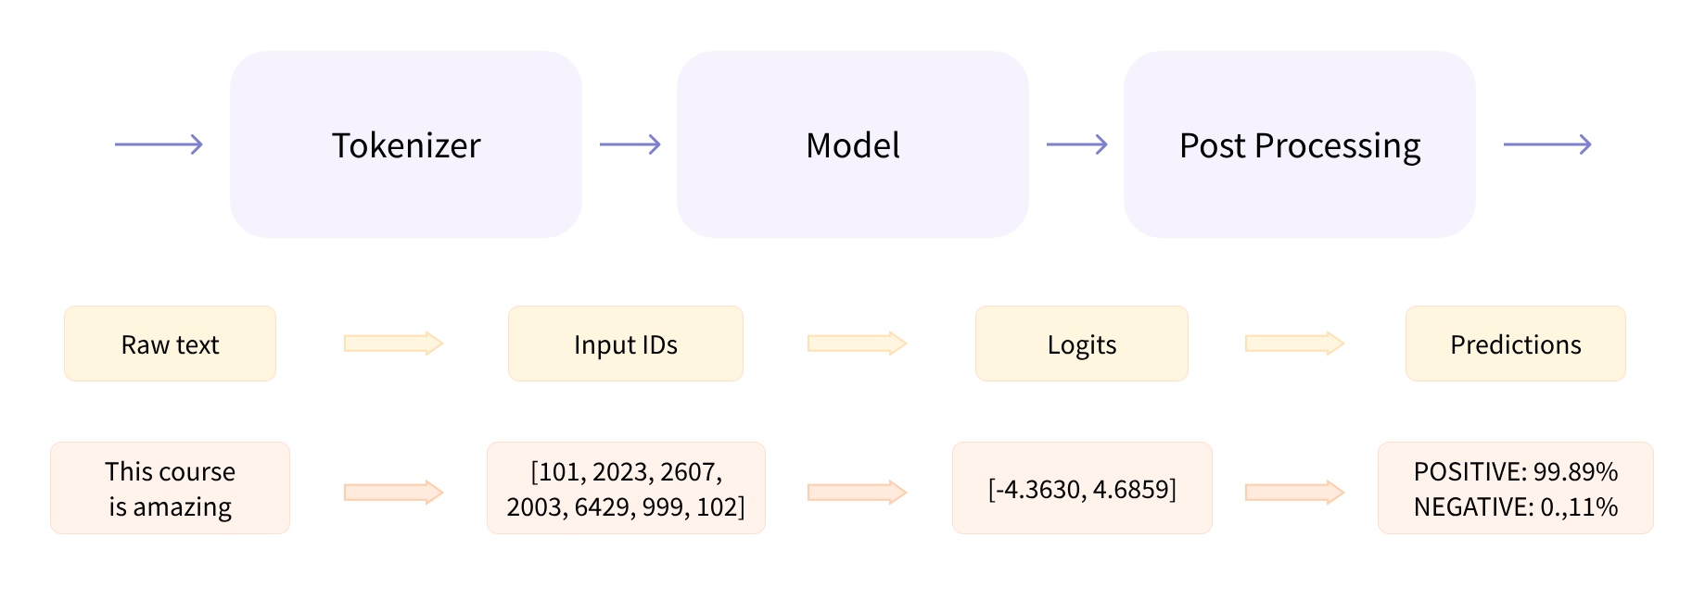
Three steps inside the pipeline function

Slide 33
Supported Tasks
Text classification (sentiment analysis, topic detection)
Text generation (LLMs, chatbots)
Named entity recognition (NER)
Question answering
Translation
Summarization
Image classification, object detection
Audio tasks (speech recognition, text‑to‑speech)

Slide 34
Using Pipelines
from transformers import pipeline
classifier = pipeline("sentiment-analysis")
classifier("Hello World! Have a wonderful day today")

